Slide 1
Effects of Rehabilitative Therapy on Sensorimotor Function in a Spinal Cord Injured Rodent Model
Jared Bartell
Jared.Bartell@asu.edu
School of Life Sciences
Center for Adaptive Neural Systems
Arizona State University
Tempe, AZ

Slide 2
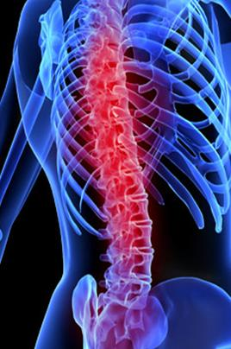
Spinal Cord Injury Background
Today, over 250,000 people in the United States are living with a spinal cord injury (SCI), with 52% considered paraplegic and 47% quadriplegic.¹
Due to improvements in palliative care and an increasing life expectancy in the general population, the number of people living with SCI is increasing with time.²
1. Spinal Cord Injury Facts & Statistics. 23 March, 2009. Retrieved from http://www.sci-infopages.com/facts.html.
2. Fouad, K. & Pearson, K., 2004. Progress In Neurobiology 73, 107-126.
Notes:
Picture taken without permission from http://www.sciam.com/article.cfm?id=nervous-system-restores-movement

Slide 3
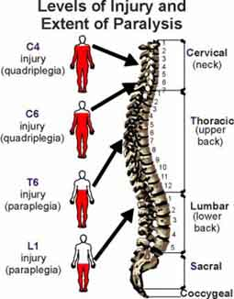
Spinal Cord Injury Background
Complete SCI:
  Complete paralysis below lesion
  Disappearance of all motor and sensory control
Incomplete SCI:
  Varying degrees of injury
  Some sparing of motor and/or sensory functionality
Notes:
Picture taken without permission from http://www.arkansas-ican.org/Spinal%20Cord%20Injury.htm

Slide 4
Rehabilitative Therapy for Promoting Recovery After Incomplete SCI
After incomplete (contusion) spinal cord injury:
Supraspinal control is impaired.
Muscle atrophy can occur due to inactivity and the absence of stimulation in areas caudal to the lesion.³
Neural reorganization (plasticity) can occur both above and below the lesion.
Certain rehabilitative therapies can promote neural plasticity that may result in some degree of functional recovery in locomotion.⁴⁻⁶
3. Dietz, V., 1992. Physiology Review 72, 33-69
4. Multon, S. et al., 2003. J Neurotrauma 20, 699–706.
5. Thota, A. K., Carlson, S., Jung, R., 2001. Biomedical Scientific Instruments 37, 63–67.
6. Thota, A. K., Watson, S. C., Knapp, E., Thompson, B. & Jung, R., 2004. J Neurotrauma 22(4) 442-465.

Slide 5
Experiment Goal and Rationale
To further determine the efficacy of rehabilitation strategies to improve the locomotion after an incomplete spinal cord injury.
Animal Model:
Contusion injury in rats mimics incomplete SCI in humans and very similar neurological mechanisms responsible in plasticity in the spinal cord.^{2,7}
Provides the opportunity to explore the biochemical, electrophysiological, and histological mechanisms involved in recovery.
Allows us to conduct more controlled laboratory experiments with non-human participants.
2. Fouad, K. & Pearson, K., 2004. Progress In Neurobiology 73, 107-126.
7. Metz, G. A., et al., 2000. J Neurotrauma 17(1) 1-17.

Slide 6
Methods
 | Treadmill Training |  | INJURY |  | Treadmill Training |  | Treadmill Training |  | Treadmill Training |  | Euthanasia
 | Testing: | PRE INJURY |  | 14 DPI |  | 21 DPI |  | 35 DPI |  | 42 DPI
Moderate contusion induced at T10 spinal cord level (thoracic vertebrae level 10) using an ultra-precise impactor device.
Four cameras recorded animal’s performance. Video later digitized and processed.
Animals euthanized and dissected to examine the spinal cord and brain tissues using histological staining techniques.

Slide 7
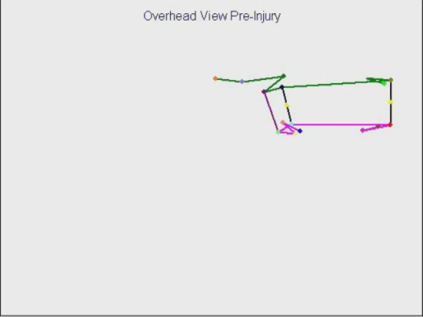
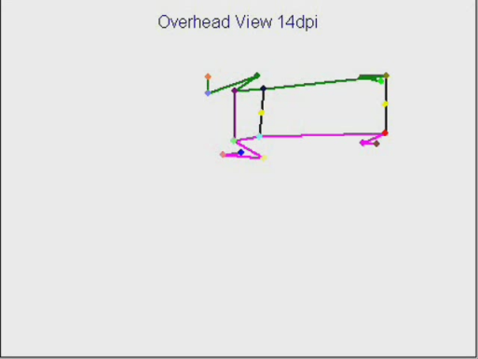
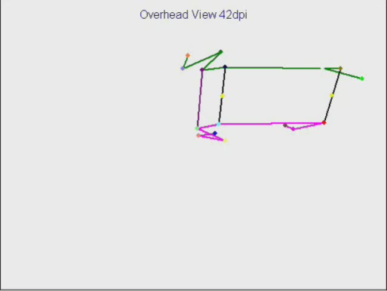
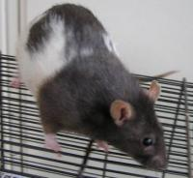
Experimental Groups
Treadmill Therapy - Repetitive training of a specific task
Functional Neuronal Stimulation (FNS) – Stimulation of sensory afferent neurons via active exercise, producing spontaneous, involuntary locomotion-like movements
No Rehabilitative Therapy (Control)
Notes:
Picture taken without permission from http://animalwelfaresolutions.net/articles/14/1/Triple-blind-science/Page1.html

Slide 8
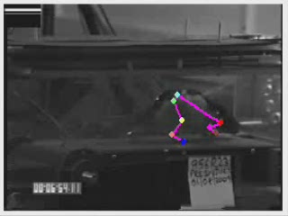
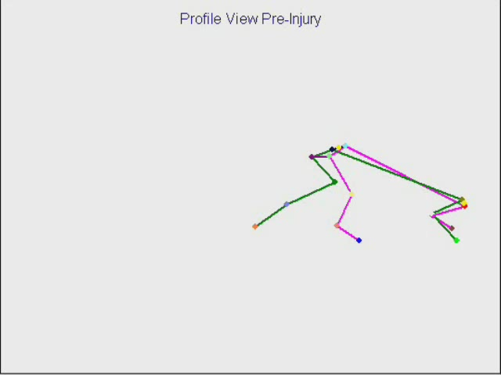

3D Kinematics Treadmill Testing
Pre-Injury

Slide 9
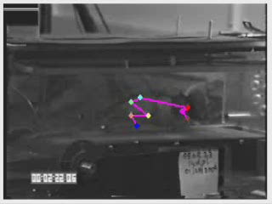
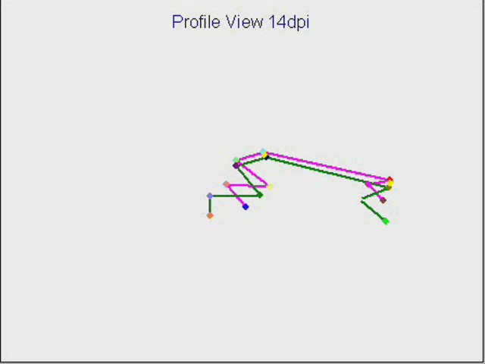

3D Kinematics Treadmill Testing
14 Days Post-Injury

Slide 10
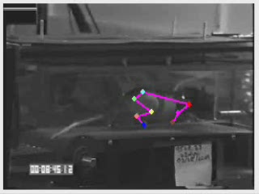
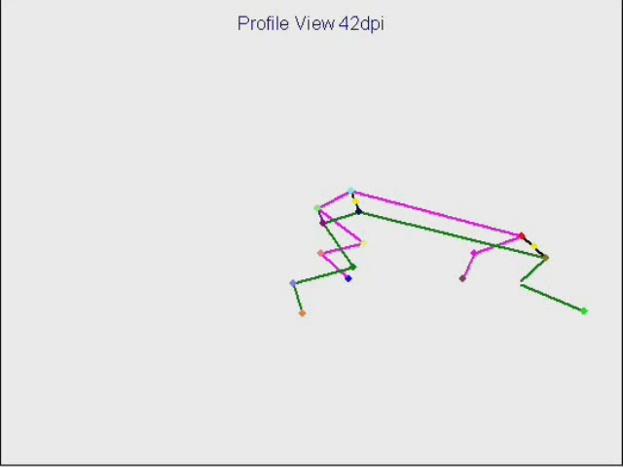

3D Kinematics Treadmill Testing
42 Days Post-Injury

Slide 11
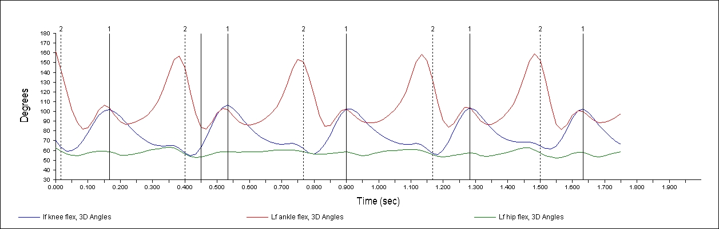
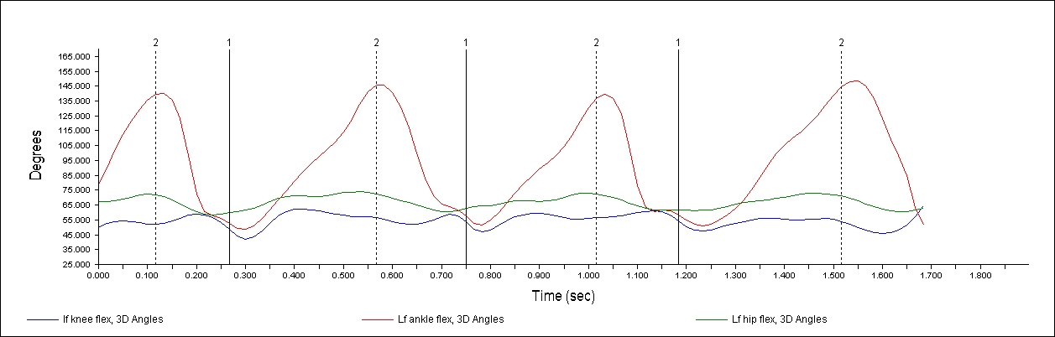
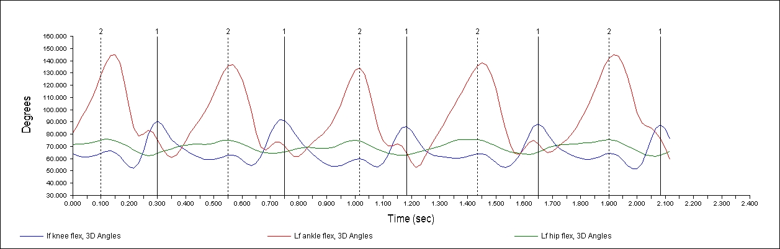
Pre Injury
Left Hind Limb
Angles
14 dpi
Left Hind Limb
Angles
42 dpi
Left Hind Limb
Angles

Slide 12
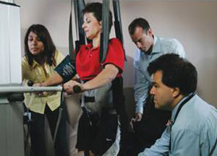
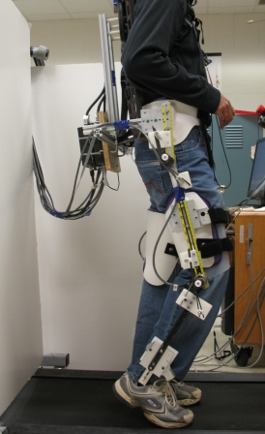
Discussion
Data analysis is still incomplete yet is actively being processed to search for relationships between groups.
Predicted order of degree of improvement: FNS >> Treadmill Therapy >> No therapy.
Both Treadmill therapy and functional neuromuscular stimulation therapy in Human models with incomplete SCI are already underway.^{8,9}
Gillette, J. C., et al., 2008. Gait Posture 27(2) 280-285.
9. Gillette, J. C. & Abbas, J.J., 2003. IEEE Trans Neural Syst Rehabil 11(4), 377-85
Notes:
Picture (Top) taken with permission from http://ans.asu.edu
Picture (Bottom) taken without permission from http://mechsys4.me.udel.edu/research/medical_robotics/

Slide 13




Acknowledgments
Ranu Jung, PhD
Director, Center for Adaptive Neural Systems, Harrington Dept. of Bioengineering, ASU
Ronald Hammer, PhD
Department of Psychology, ASU; U of A College of Medicine - Phoenix
Mallika Fairchild
Center for Adaptive Neural Systems, Harrington Dept. of Bioengineering, ASU
Brian Hillen
Center for Adaptive Neural Systems, Harrington Dept. of Bioengineering, ASU
Alex Iarkov, PhD
Center for Adaptive Neural Systems, Harrington Dept. of Bioengineering, ASU
Thank you!
http://ans.asu.edu

